Slide 1
Module 4.2:
Fairness
Creating fair and ethical ML models for cybersecurity
ML for Cybersecurity

Slide 2
Adversaries
Ethics
Attacker’s goals
Attacker’s capabilities
Robustness of model/feature
Privacy
Fairness
Transparency
Modules 2 – 4
Module 4
Module 2
Module 1
Identify Goals & Collect Data
Data Representation
Modeling
Deployment
Pinpoint needs
Data acquisition
Data labeling
Data exploration
Data cleaning
Missing data
Feature selection
Consider fairness
Efficiency
Accuracy
Interpretability
Adversarial resistance
Performance
Evasion and attacks
Model drift
Impact on stakeholders
Module 3

Slide 3
FAIRNESS in the MEDIA

Slide 4
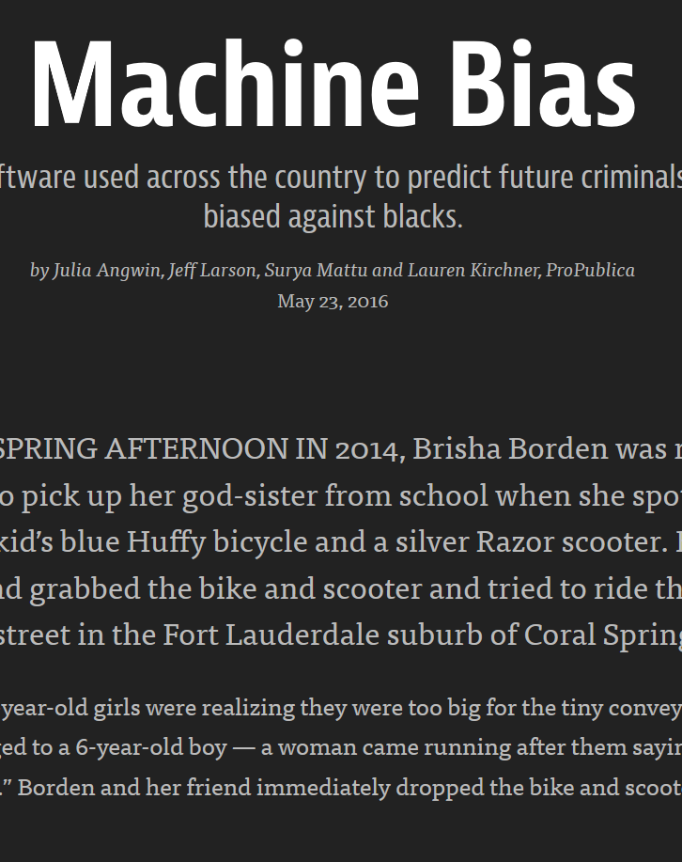
COMPAS System
Used for risk assessments (bail)
Based on answers to 137 questions
ProPublica obtained data from Broward County, Florida
Media: “It’s biased against blacks.”
Model author: It’s equally accurate across demographic groups!

Slide 5
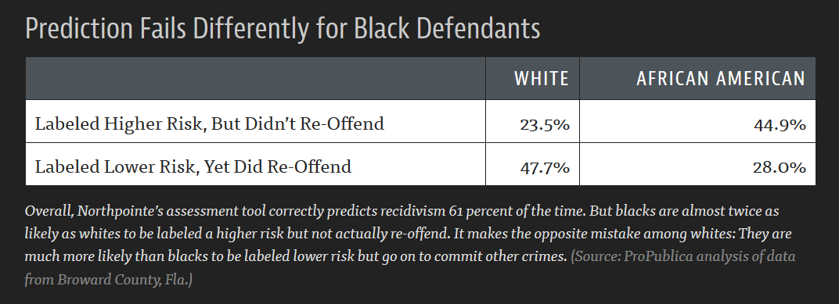
COMPAS System: Evidence of Discrimination?

Slide 6
Challenges for Cybersecurity ML
What if ML model for detecting fraudulent accounts is more likely to accidentally flag accounts of men as fraudulent?
Risks of accidentally locking a valid account include:
Unnecessary help desk calls
Customer abandonment
Stranding a customer or negatively impacting their opportunities
Negative stories in the press
What recourse does a customer have?

Slide 7
Difficulty Of Being Fair

Slide 8
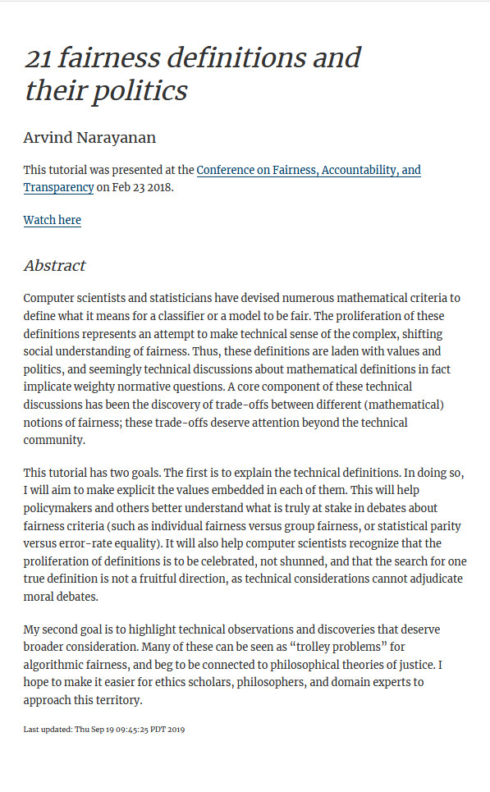
Defining Fairness
Dozens of potential definitions!
Terms conflated across disciplines
Political philosophy
Employment law
Computer science
See: Deirdre K. Mulligan, Joshua A. Kroll, Nitin Kohli, Richmond Y. Wong. This Thing Called Fairness: Disciplinary Confusion Realizing a Value in Technology. PACM HCI (CSCW), 2019.

Slide 9
Definition 1: Individual Fairness
“Similar people should be treated equally”
One of the early definitions of fairness
How do you define “similar”?
What if one class of “similar people” is treated poorly?

Slide 10
Definition 2: Group Fairness
Statistical non-discrimination
Basis in employment and housing law (e.g., Fair Housing Act)
Primarily considers protected classes
Race, gender, sex, national origin, religion, marital status, etc.
Goal: approximately equalize some quantities across demographic groups
Focus on disparate impact (treating different groups differently)

Slide 11
Definition 2: Group Fairness (Example Metrics)
Demographic parity (equal outcomes)
Equalize the chance of positive classifications across groups
Equalized accuracy across groups
Equalized odds (true positive rate and false positive rate are equal)
… many more!

Slide 12
Definition 2: Group Fairness (Example Metrics)
Problem: You can’t equalize all (or even most) definitions!
See Chouldechova, “Fair prediction with disparate impact: A study of bias in recidivism prediction instruments,” Big Data 2017, https://arxiv.org/abs/1703.00056
See Kleinberg et al., “Inherent trade-offs in the fair determination of risk scores,” ITCS 2017. https://arxiv.org/abs/1609.05807

Slide 13
Definition 3: Process Fairness
Exclude from the model predictor variables that are deemed to be unfair for the classification task
Important question: Who gets to decide what is fair? Is it majoritarian voting? Should it be experts in law/technology?
Beware of proxy variables (other variables correlated with variables you intend to exclude)

Slide 14
Business Applications

Slide 15
What Would You Do?
A classifier for potential phishing emails
A classifier for images that represent hate speech
A classifier that detects DDoS attacks on your network
What definition(s) of fairness do you prioritize?
What are potential business consequences?
At what point in the modeling process do you test for fairness?

Slide 16
Tools

Slide 17
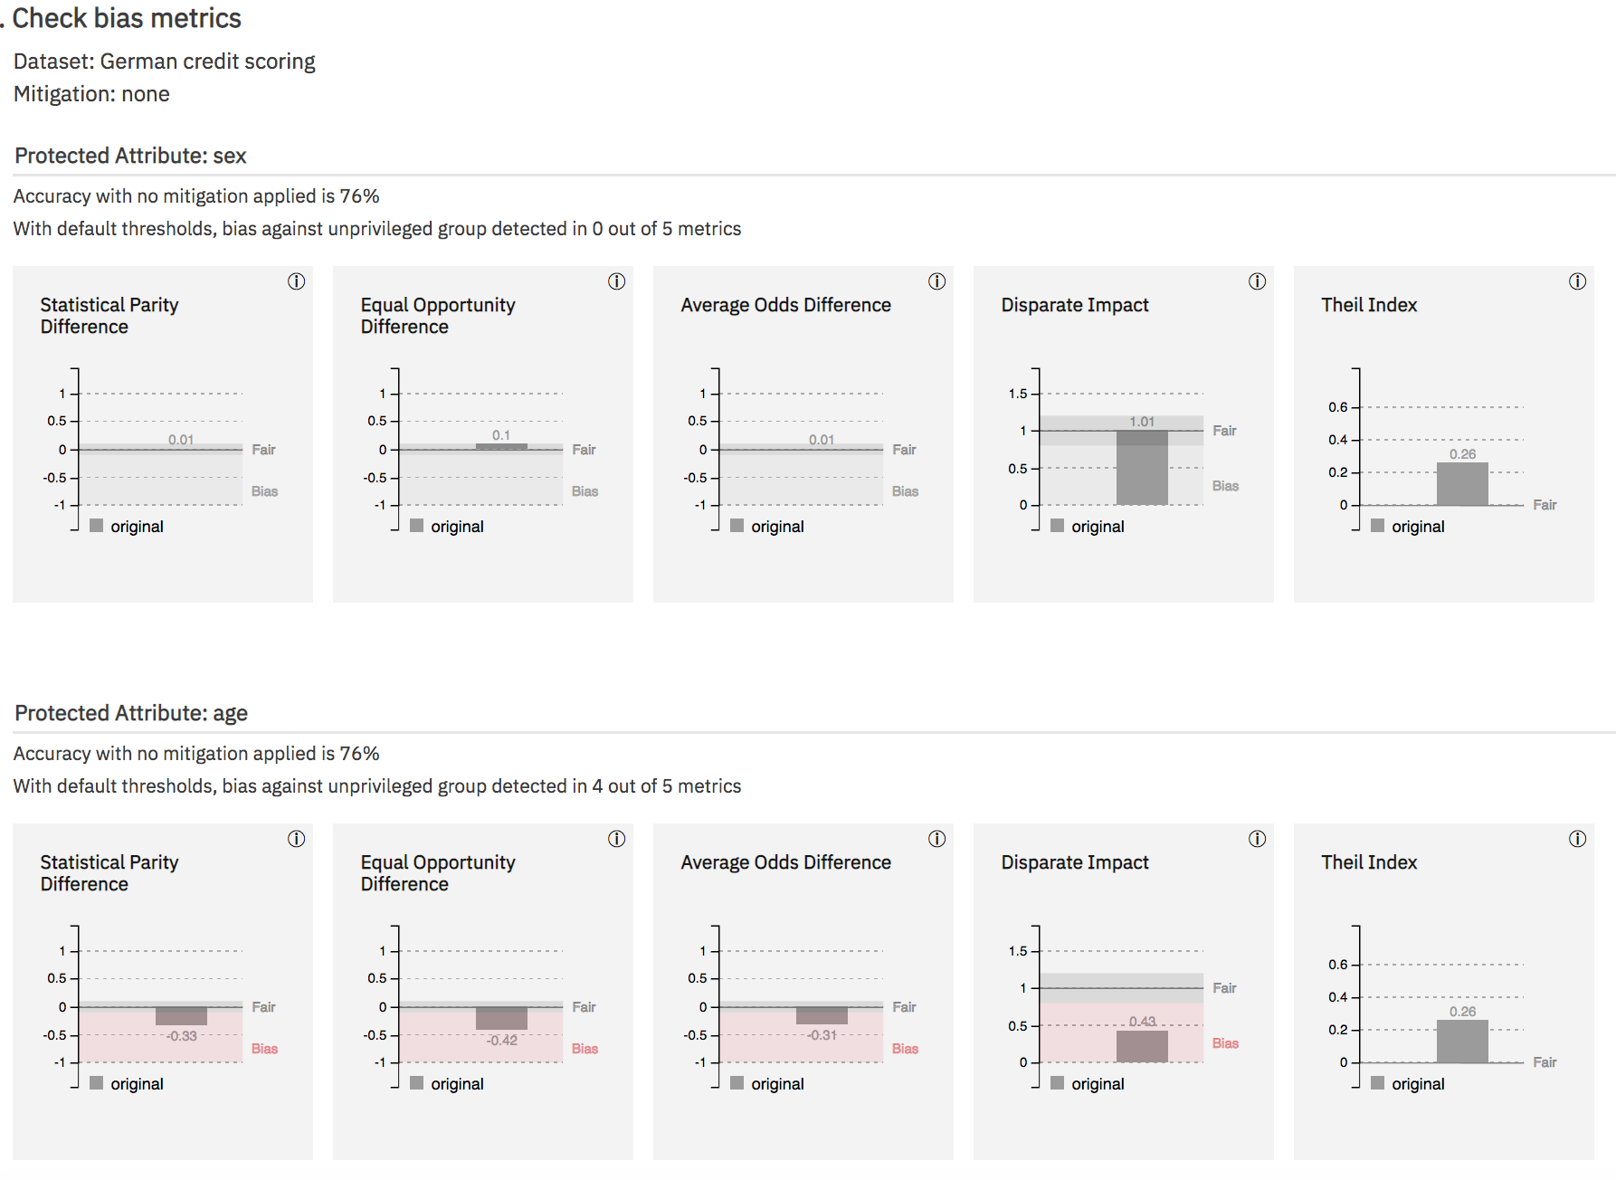
IBM AI Fairness 360

Slide 18
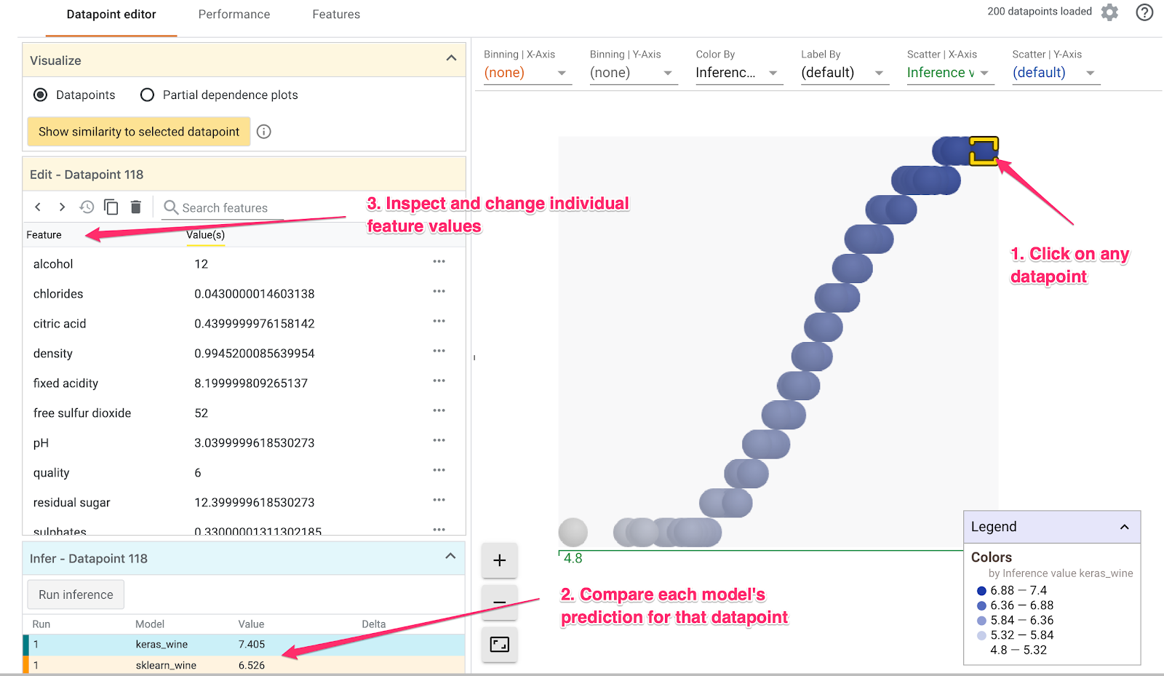
Google What-If Tool

Slide 19
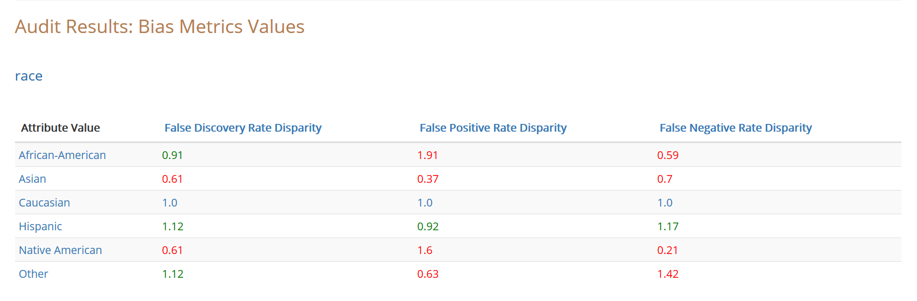
UChicago Aequitas Tool

